Slide 1
Leadership Boot Camp
Notes:
1

Slide 2

Introductions
Speak for 2 minutes about yourself

Slide 3
Leadership Characteristics
What are the characteristics of a good leader?
Notes:
3
There is no definitive list of characteristics that describes all leaders
No two leaders have the exact same sequence of strengths
They may have identical expectations, but the way they reach their goals is always dependent on their unique arrangement of their strength

Slide 4
Four Parts of Leadership
Know Yourself | Communicate Effectively
Be a Good Team Player | Continuous Improvement
Notes:
Ask for ideas about what’s an example of a good team player
Self awareness is a crucial part in personal development

Slide 5
Biases
Affect the way you interact with people
Okay to have biases and beliefs because it makes up who you are
Important to put them in check
Notes:
So if a student is acting out at a meeting, you may assume it’s because they don’t want to be there or have a bad attitude. But that may not be the case. They may have ADD or had a rough day. You can’t make assumptions about people because then it’ll affect your response to them.
Empathy allows you to see past the bias. Try to understand the other reasons of why they may be acting out. Try asking some questions about what’s going on with them to have some understanding of the situation. And then you can understand how to resolve it in a non-confrontational or negative way.
You make an assumption, the person feels hurt by that assumption (the way you spoke to them, what you said to them, the fact that you’re assuming the wrong thing about them), they get defensive and now it creates a conflict.
Helps you understand any barriers or limitations you may have

Slide 6
Biases
Write down some biases and beliefs you have.

Slide 7
Investing In Strengths
Without an awareness of your strengths, it’s almost impossible for you to lead effectively
    Focusing on your or others’ strengths builds confidence
    People with higher self-confidence ended up with higher income levels and career satisfaction
We all lead in different ways, based on our talents and limitations

Slide 8
Strengths
You cannot be anything you want to be, but you can be a lot more of who you already are
Notes:
You should all know or be familiar with the story/movie of Rudy. About a guy who wanted to be on the Notre Dame football team. He got denied to Notre Dame 3 times and was finally accepted. For 2 years, he joined the practices and never played in a game until the final one of his senior year. He tackled the opposing team’s quarterback in the final play and he became a hero. This story highlights the fact that our society is about overcoming deficits, or triumphing over one’s lack of natural ability. And this is the path of MOST resistance. We do not recognize those who capitalize on their innate talents as much. For example, most parents in the US say that a student’s lowest grades deserve the most time and attention. Excellence is rewarded with apathy instead of investing more time in the areas where a student has the most potential for greatness. A person who has always struggled with numbers is unlikely to be a great accountant or statistician. Even Michael Jordan who embodied the power of raw talent on a basketball court could not become the Michael Jordan of golf or baseball, no matter how hard he tried. Each person has greater potential for success and the key is building upon who you already are and what your natural talents are.

Slide 9
Strengths
Talent
  Innate
  Less likely to change
Investment (knowledge, skills, practice)
  Key components to tapping into those talents
Notes:
A study showed that personality traits at age 3 were remarkably similar at age 26. Your natural talents are less likely to change.
It’s easy to add knowledge and skills. For example, taking a course on programming.
It is easy to describe our acquired expertise, but it is difficult sometimes to describe our natural talents.
Some talents can be communication: you can easily strike up a conversation with someone, create an engaging story, or come up with the perfect word. Other talents can be Responsibility – one who has a natural dependability, commitment and doesn’t make excuses.

Slide 10
Know Yourself
Talent
(a natural way of thinking, feeling, behaving)
X
Investment
(time spent practicing, developing your skills, and building your knowledge base)
=
Strength
(the ability to consistently provide near-perfect performance)
Notes:
For example, while Rudy might have scored a perfect 5, on a scale of 1 to 5, for investment (time he spent practicing and building his knowledge and skills of football), let’s assume he was on a 2 on the talent scale. So his maximum potential for building strength is this area is 10, even when he scored highest on the investment scale.
It is likely that Rudy had teammates for whom the inverse was true – they were a 5 in talent, but a 2 in investment, which is a waste of talent. If you were to scale Joe Montana, considered a great football player, and alum of Notre Dame, you could guess that he was a 5 in talent and a 5 in investment. This gives him a score of 25, which is obviously much higher than Rudy’s score of 10.

Slide 11
“If you spend your life trying to be good at everything, you will never be great at anything.”

Slide 12
Know Yourself
List 3 of your strengths/talents

Slide 13
Know Yourself
Take the test!
http://richardstep.com/richardstep-strengths-finder-rssf/
Notes:
Share their 5 talents

Slide 14
Maximize Your Team
Recruit based on the individual’s strengths and how they can maximize the rest of the group’s strengths
Four distinct domains of leadership strength:
    Executing: know how to make things happen
    Influencing: help their team reach a broader audience; selling the team’s ideas inside and outside the organization
    Relationship Building: hold the team together
    Strategic Thinking: keep everyone focused on what could be; help the team make better decisions
Notes:
There is a table on page 3 in your work book that shows where your talents fit. Take a few minutes to find out where your strengths fall in the four domains. Give them 5 minutes to share.

Slide 15
Maximize Your Team (cont)
A good team has representation of each of these domains – makes a well-rounded team
  Example - My strengths are:
Executing | Influencing | Relationship Building | Strategic Thinking
Achiever | Command |  | Intellection
 |  |  | Analytical
 |  |  | Input

Slide 16
“The most effective leaders stay true to who they are – and then make sure they have the right people around them to create unprecedented growth.”

Slide 17
Understanding Why People Follow
Critical to know what the people around you need and expect from you
Followers’ 4 Basic Needs:
    Trust (honesty, integrity, respect)
    Compassion (caring, friendship, happiness, love)
    Stability (security, strength, support, peace)
    Hope (direction, faith, guidance)
        A higher level need; future
Notes:
17
The chances someone will do good work if they do not trust their leader is 1/12. If they trust their leader, it’s 1 in 2 (a 6 –fold increase)
Trust – when two people know each other well, they tend to work faster
Compassion – people who feel like they are cared about are more likely to stay with the organization and are more engaged in team activities
Hope – When hope is absent, people lose confidence

Slide 18
Understanding Why People Follow
Leaders who are always reacting to the demands of the day don’t convey control (Responder)
Leaders who initiate can create hope for the future (Initiator)
  Cleaning out your inbox is an easier task than figuring out how to increase our recruitment for next year
Are you an Initiator or a Responder?
Notes:
18
Solving problems and removing barriers becomes more natural as initiating is harder work
You can almost argue that Responders are not leaders at all. Leaders are supposed to LEAD people.

Slide 19
Benefits of being an Initiator
Less time spent putting out fires, more time put towards improvements on current items or creating new items
Reactors are always behind, initiators are always ahead
Initiators can plan their time more efficiently, Reactors are always on call
Initiators generally get more things done and fare well in their careers as compared to Reactors.

Slide 20
“The most extraordinary leaders do not see personal success as an end in itself. They realize that their impact in this world rests in the hands of those who follow.”

Slide 21
The 7 Habits of Highly Effective People
Be Proactive
Begin with the End in Mind
Put First things First
Think Win/Win
Seek First to Understand, then to be Understood
Creative Cooperation
Sharpen the Saw
Notes:
Be Proactive (go to next slide)
Creative Cooperation
Teamwork, open-mindedness, the adventure of finding new solutions to old problems
Trust & Cooperation are HIGH
Find the 3rd Alternative: a better way that hasn't been thought of yet.
Sharpen the Saw: Balanced Self Renewal, continuous improvement, improving upon your talents by investing in them with knowledge and skills
Balanced program in the four areas of your life: physical, social/emotional, mental, and spiritual

Slide 22
Proactive/Reactive Language
Reactive
There’s nothing I can do
That’s just the way I am
He makes me so mad!
They won’t allow that
I have to do this
I can’t
I must
If only
Proactive
Let’s look at the alternatives
I can choose a different approach
I control my own feelings
I can create an effective presentation
I will choose an appropriate response
I choose
I prefer
I will

Slide 23
Improving/Maintaining Relationships
Understand the person
Keep commitments (stability)
Clarify expectations
Attend to little things (say “Thank you!”)
Show personal integrity (moral character)
Willing to admit when you’re wrong or when you’ve wronged the person
http://www.lifetrainingonline.com/blog/the-emotional-bank-account.htm

Slide 24
“Leaders are only as strong as the connections they make with each person on their team.”

Slide 25
Seek First to Understand,
Then to be Understood
Principles of Empathic Communication
Empathic Listening (putting yourself in the other person’s shoes)
Diagnose before you Prescribe
I statements
Understanding & Perception
THEN Seek to be Understood
Notes:
25
Because you so often listen autobiographically, you tend to respond in one of four ways:
Evaluating: You judge and then either agree or disagree.Probing:You ask questions from your own frame of reference.Advising:You give counsel, advice, and solutions to problems.Interpreting:You analyze others' motives and behaviors based on your own experiences.

Slide 26
Empathy
Unconditional positive regard, empathy and genuineness are important in everyday life
Unconditional positive regard
  respecting and accepting a person as a competent individual, including his or her strengths, weaknesses, and full range of feelings and behaviors
Knowing that one is “heard”, that one is accepted, and that someone else understands and cares underlie caring, helpful interactions

Slide 27
Tips on Being a Good Listener
Eye contact
Be aware of body language (minimize barriers)
Minimize distractions (looking out the window, fidgeting, side conversations)
Notes:
Part of empathy is being a good listener

Slide 28
The 8th Habit
Find your Voice and Inspire others to find theirs
Leadership is a choice to deal with people in a way that will communicate to them their worth and potential so clearly they will come to see it in themselves
Develop a shared vision

Slide 29
“The most effective leaders forever alter the course of your life.”

Slide 30
ACTIVITY!

Slide 31
Communicating & Persuading
Penfield Robotics
Leadership Boot camp 2010

Slide 32
Agenda
Art of Persuasion
Elements of Oratory
Video: M. L. King Speech
Planning a Talk
10 Presentation Tips
On Your Feet

Slide 33
The Art of Persuasion
Art of Persuasion more important
than ever because of:
  Decline of top down leadership
  Rise of teambuilding
Requires Communicating Effectively!

Slide 34
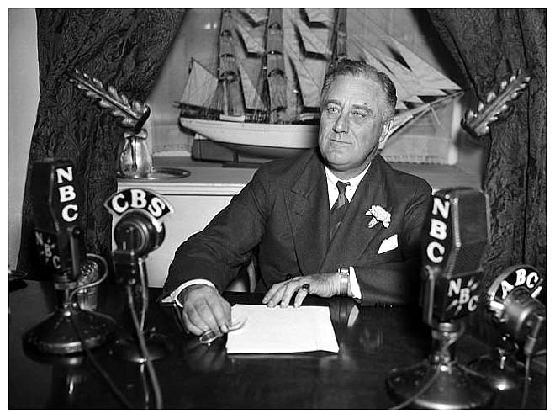
Thought for the Day
FDR on Public Speaking
“Be prepared,
be brief,
be seated”
Franklin Delano Roosevelt

Slide 35
Three Keys to a Great Talk
Elements of oratory
Narrative
Finding one’s own voice

Slide 36
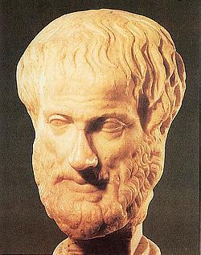
Greek Elements of Oratory
Source- Aristotle,
Rhetoric, 355 B.C.
Ethos- Credibility & Likability
  Why should we care what you say?
  Your introduction can establish “ethos”
  Self deprecating humor breaks down barriers

Slide 37



Elements of Oratory (Cont.)
Logos- Strength of Argument
  3 points are often effective. Say 3 of anything and people will start writing them down.
  Support arguments with facts & figures. Best are surprising (Stickiness Factor)

Slide 38
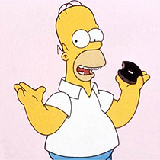
Thought for the Day
“Facts are meaningless; you can use facts to prove anything that’s even remotely true! Facts, schmacks.”
Homer Simpson
1997

Slide 39

Elements of Oratory (Cont.)
Pathos- Appeal to the Heart
  Leadership is not just from the head up, but neck down too.
  Values can be more powerful than facts.
  (“If we really believe XX, then we must do YY.”)

Slide 40
One Common Approach
Open with Ethos-- Establish credibility
Argue with Logos-- Make your case
Close with Pathos-- Send them away wanting more (Upper vs. Downer)

Slide 41
Narrative
Stories appeal to people
Long ones better have a good punch line
Stories must be relevant and make a point
Often effective to bring past and future to the present
  Where we have been
  Where we are now
  Where we are going

Slide 42
Finding Your Own Voice
“Voice” is your style, your perspective
Consistency is a virtue. People won’t trust you if you’re all over the lot.
Followers want the Deeper Level
  -Who you are -The Inner You
Passion must be authentic. Nobody follows a phony.

Slide 43
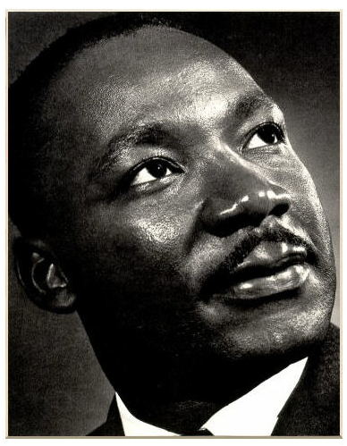
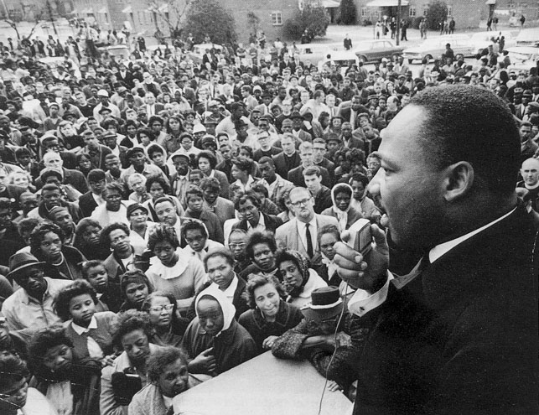
Martin Luther King, Jr.
“I Have A Dream”
August 28, 1963

Slide 44
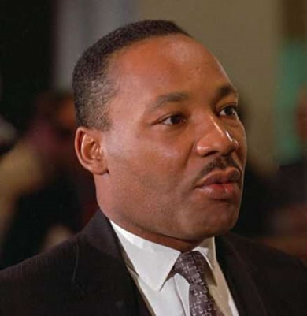
“I Have a Dream”
How does King use the Greek elements of oratory? Give some examples.
What, for you, are the most effective parts of the speech? Why?
What makes the speech
still relevant today?

Slide 45
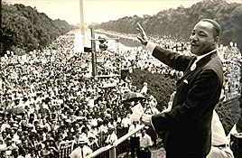
“I Have a Dream”
Suppose Dr. King asked you to write a talk about race relations for him to deliver on the Mall this Aug 23 (the anniversary of the speech)
  What would be the message or central theme?
  How would the language differ
  from the original speech?

Slide 46


Composing A Talk
Who Is My Audience? Understand your immediate and extended audience. What stories, metaphors, and language will connect with them?
What Is It You’re Going to Say? Know with precision. Reduce to one paragraph. Write it out.

Slide 47
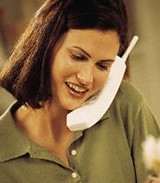



Composing A Talk (Cont.)
How Will the Broader Audience Hear or Read What I’ve Said? Audience beyond the room may get hearsay or read sound bites. How well will your message travel?
Who Are You and What’s Your Voice ?
Your talk must sound like you.

Slide 48
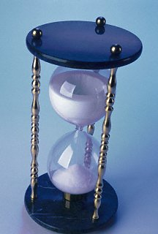
Tip #1 for a Great Presentation
Start early. Remember the
1 minute = 1 hour rule
Work expands to fill the time
available to complete it

Slide 49
Tip #2 for a Great Presentation
Be sure you know (and don’t forget)
  Who is your audience?
  What is your purpose? (inform, persuade, entertain, other?)
  What is your message?

Slide 50
Tip #3 for a Great Presentation
Decide on an approach for the presentation.
  Top Down
  Bottom Up
  Other
Some plan beats no plan

Slide 51
Tip #4 for a Great Presentation
Three rules for powerful presentations
  Focus on something you really care about
  Incorporate personal experiences in your presentation
  Structure your presentation like a story
Communicate meaning - not just words

Slide 52
Tip #5 for a Great Presentation
Use audio/visual aids sparingly & only to enhance your narrative
  What kind of aids to use? (photos, samples, flip charts, video clips, others)
  Where, why, how many?
  Avoid aids that are distracting or increase risk of failure
The PowerPointless Challenge

Slide 53
Tip #6 for a Great Presentation
Three steps for better PowerPoint slides
  Emphasize graphics not words
  Use reverse contrast color schemes
  Keep them simple
Follow the 6 X 6 rule

Slide 54
Tip #7 for a Great Presentation
Own the room!
  Rehearse where you will speak
  Check out all equipment in advance
  Always have a “Plan B” in case of failures
Never Forget - S#*T Happens!

Slide 55
Tip #8 for a Great Presentation
Some strategies for managing stage fright
  Prepare & learn your material (memorize it all, speak from notes, read text but memorize first & last minute)
  Focus on the audience, not yourself
  Employ effective eye contact (3 second guide)
  Psych yourself up! Turn anxiety into energy
The audience wants you to succeed

Slide 56
Tip #9 for a Great Presentation
The final steps to a great presentation
  1. Rehearse and revise.
  2. Rehearse and revise
  3. Repeat steps 1 and 2
Reinforce what’s good - Revise what’s not

Slide 57
Tip #10 for a Great Presentation
?????
- What would you suggest?

Slide 58
Creating a Vision and Strategy

Slide 59
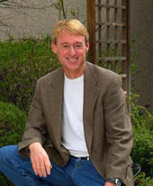

Thought for the Day
“It takes the same amount of effort to think big as it does to think small, and when you think big you get paid for it.”
  Mo Siegel
  Founder, Chairman &CEO
  Celestial Seasonings, Inc.

Slide 60
Domain of Strategic Leadership
Vision
Mission
Strategy
Implementation
  Strategic Leadership Is Often Key to Success

Slide 61
Strategic Leadership Is:
Broad in scope- Strategic decisions impact areas outside your own functional area, business unit or even the organization.
Future focused- Strategic work takes place over long periods of time.
Change oriented- The strategic leader is often a driver of organizational change.

Slide 62
Leadership Vision
Attractive, ideal future which:
  presents a challenge
  requires people’s best
What Vision Does
  Links present to future
  Energizes people
  Gives meaning to work
  Sets standards of excellence

Slide 63
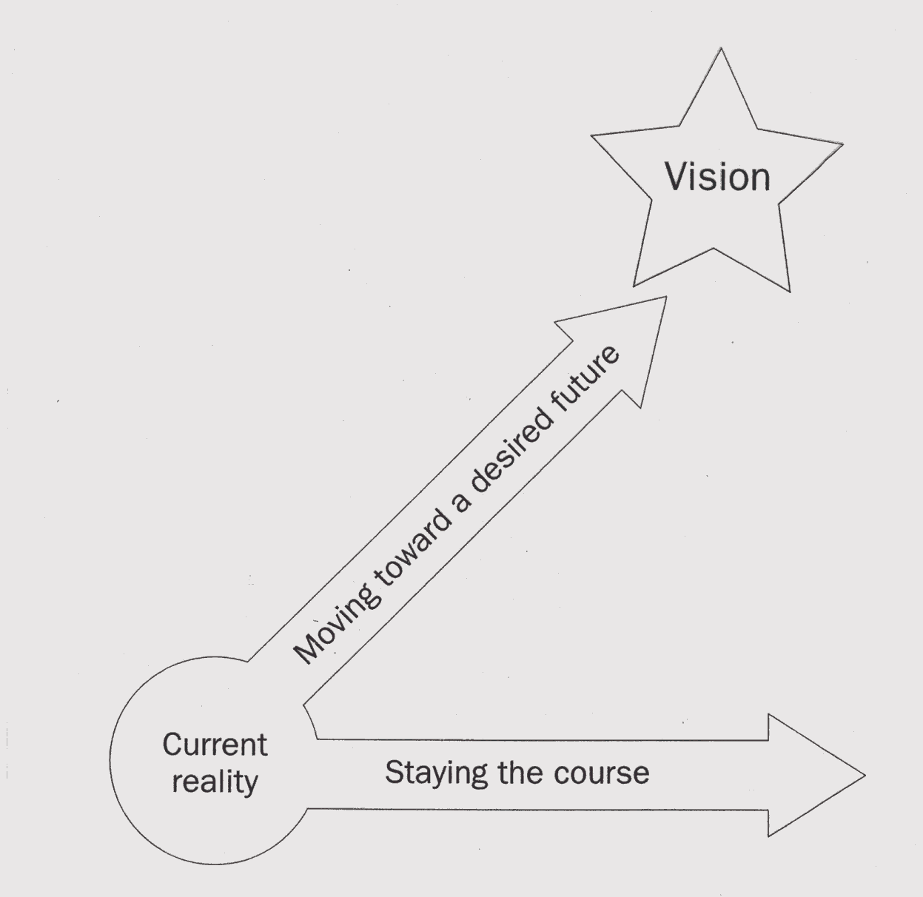
Nature of the Vision

Slide 64
Common Themes of Vision
Has Broad Appeal
Deals with Change
Encourages Faith & Hope
Reflects High Ideals
Defines the Destination & the Journey

Slide 65
Linking Vision With Values
Values: beliefs & principals that guide company operations and individual behavior
“Values are what we will do no matter what!”
Strategic Vision Must Reflect Core Values

Slide 66


Core Values
U. S. Air Force
  Integrity
  Service Before Self
  Excellence in All We Do
IBM
  Respect for Individuals
  Best Service in the World
  Excellence of Performance

Slide 67
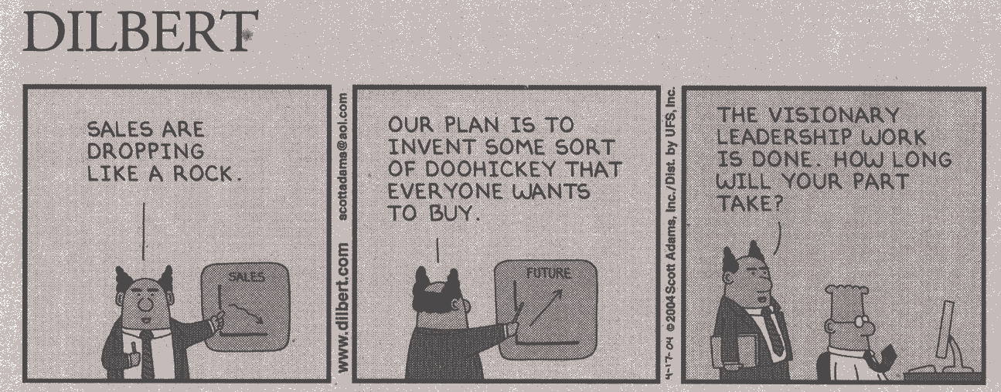
Leadership is Not Just Vision

Slide 68
Mission
Not the same as Vision
Mission reflects the organization’s
  Broad purpose
  Reason for existence
Defines core values & core purpose
Visions grow & change; Missions endure
Mission Says Why We Are in Business

Slide 69


Corporate Mission Statements
Six Flags Entertainment Parks
  “to create family fun and fond memories”
United Airlines
  “to be recognized worldwide as the airline of choice”

Slide 70
What Are Strategies?
Strategies are Plans of Action
Relate Means to Ends
Allocate resources to achieve goals
Focus on
  Core Competencies
  Synergy
  Creating Value

Slide 71
Business Strategy Defined
Strategy: The configuration of a firm’s resources in relation to it’s environment. Strategy involves deciding how to allocate scarce resources
Strategic Decisions:
  Are important
  Wide ranging
  Spawn other decisions

Slide 72
The Strategic Domain
Strategy
Interface of
Organization
&
Environment
Organization
Strengths and
Weaknesses
Environment Poses Both
Opportunities and Threats

Slide 73
Three Key Questions?
Where are we now?
  Internal & external environmental assessment
Where do we want to go?
  Strategic vision & intent
How will we get there?
  Strategy & implementation

Slide 74
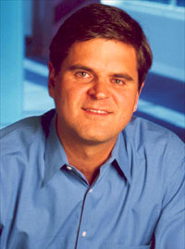

Another Thought for the Day
“In the end, a vision without the ability to execute is probably a hallucination.”
Stephen M. Case
Chairman, AOL Time Warner

Slide 75
Strategy Implementation
Most important & difficult part of all
Implementation uses tools & parts of organization
  Personal leadership -Organizational Design
  Pay & Rewards -Budget Allocations
  MIS Systems -Policies & Procedures
Key Questions- “Do we have the tools?
What new ones do we need?”

Slide 76
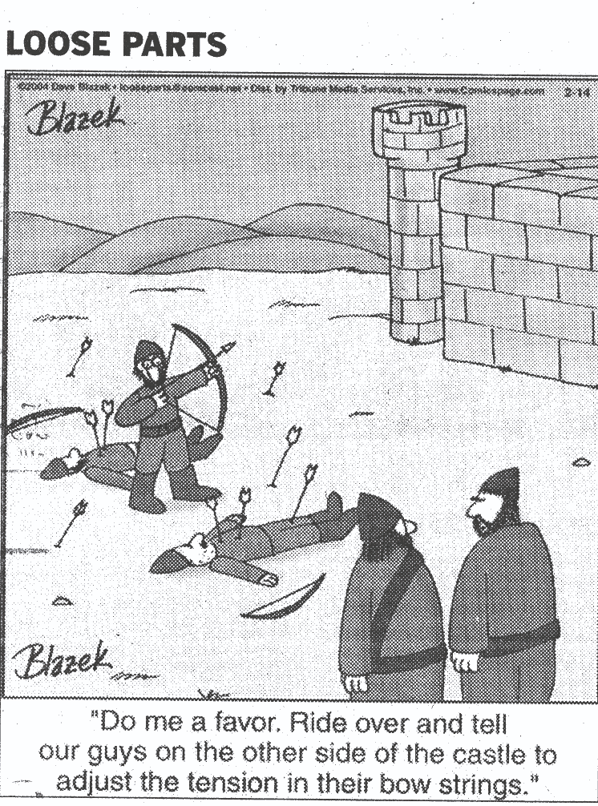
Fine Tuning
Strategy Implementation

Slide 77
Henry’s Battle at Agincourt
The Environment and External Situation
Henry’s Mission
Core Competencies & Competitive Advantages
The English Strategy
Henry’s Vision- The St. Crispian’s* Day Speech before the Battle of Agincourt
*October 25, 1415

Slide 78
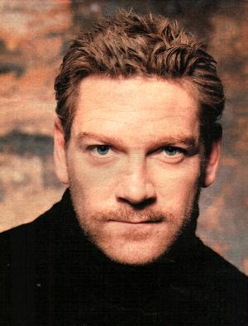

Henry at Agincourt
From the film “Henry V”
by William Shakespeare
(10 min.)
Starring: Kenneth Branagh
Derek Jacobi
Paul Scofield

Slide 79

How Did Henry’s Vision?
Link Today & Tomorrow?
Energize People?
Give Meaning to Work?
Set Standards of Excellence?
How did he do it? Give examples.

Slide 80
The Bottom Line
Strategy & leadership are often the winning difference
Vision inspires and aligns people
Strategy is important, but implementation is critical
Great leaders Link Vision and Strategy

Slide 81
Strategic Leadership
Strategic Leadership relates:
  Vision Mission
  Strategy Implementation
Strategic Leadership Often Key to Success

Slide 82
Strategy Making Process
Making good strategy is both:
  Longer & Shorter Term
  Proactive & Reactive
  Structured & Fluid
  Offensive & Defensive
  Periodic & Continuous

Slide 83
Recipe for Making Strategy
Develop a strategic vision
Set measurable objectives
Craft a strategy to achieve them
Implement & execute the strategy
Evaluate performance & modify as necessary

Slide 84
Who Crafts Strategy?
CEO is ultimately responsible for strategy
Senior executives lead the effort
Division & Product Heads have key roles
Every manager contributes in their area
Give People a Stake in the Strategy
They Will Be Responsible for Implementing

Slide 85
Did Henry’s Themes Have?
Broad Appeal?
Deal with Change?
Encourage Faith & Hope?
Reflect High Ideas?
Define the Destination & the Journey?
How Did He Do It? Give examples.

Slide 86
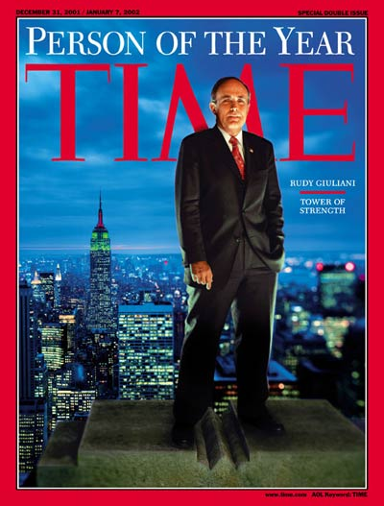
Leading in a Crisis:
What It Takes

Slide 87
What is a Crisis?
Webster’s definition
Crisis- any situation that is decisive, critical, severe, or trying

Slide 88
Opening Discussion Questions
What factors made 9/11 a unique crisis?
What prepared New York City for 9/11?
  (Institutional factors)
What prepared the Mayor for 9/11?
  (Personal Factors)

Slide 89
What factors made 9/11 unique?

Slide 90
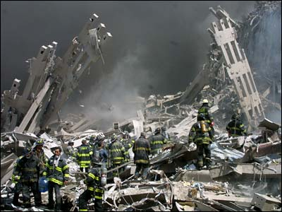
Unique Factors in 9/11 Crisis
Size & scope of disaster
Element of surprise & shock
Violation of our safe space
Required local, state, and federal response
Public reduced to Maslow’s lowest level (food, shelter, security & safety)

Slide 91
What Prepared NYC for 9/11?
Institutional Factors

Slide 92
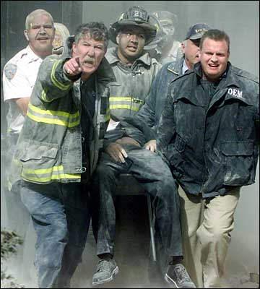
What Prepared NYC for 9/11?
Institutional Factors
Experience with 1993 WTC bombing
Creation of Office of Emergency Management
Pre-delegation of authority to act
Eight years of emergency drills

Slide 93
What Prepared the Mayor for 9/11?
Personal Factors

Slide 94
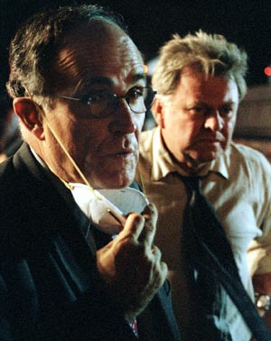
What Prepared the Mayor for 9/11?
Personal Factors
Strategic/systems thinker (former U.S. Attorney)
Perseverance/Drive
Ability to take the heat (prior OEM criticism)
Experience with multiple crises (TWA, Louima, School Chancellor)
Lame Duck- high credibility, no agenda

Slide 95

Thought for the Day
On Performance Under Stress
“Put people in a new situation, a foreign environment, and you’re taking away about 100 points of their I.Q. And not all of us have 100 points to lose”
U.S. Army Ranger Officer

Slide 96
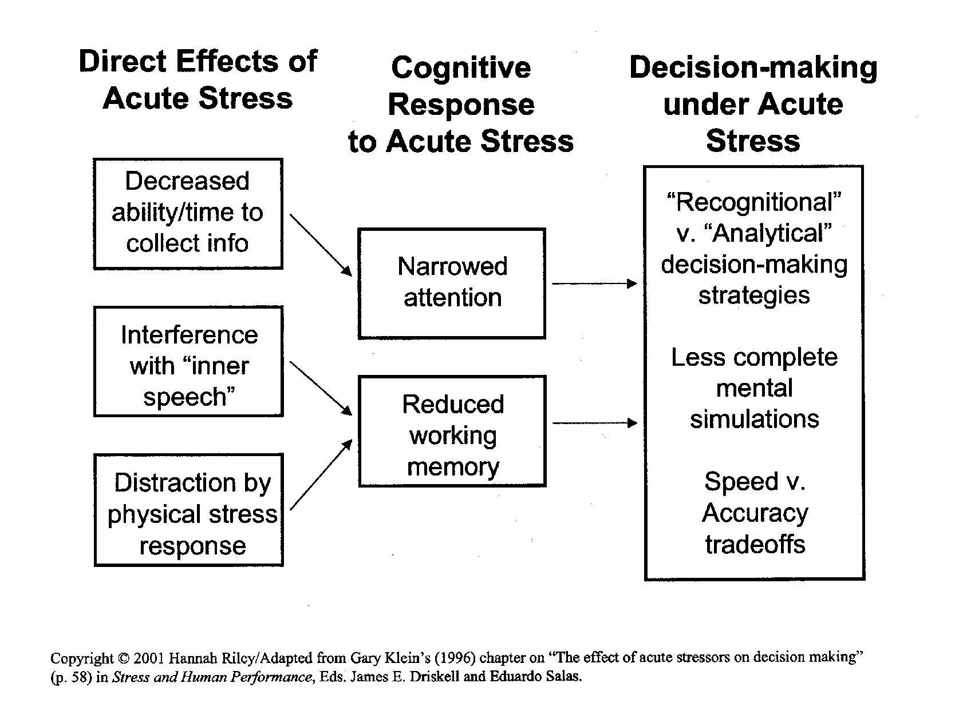
Direct Effects of Stress

Slide 97
Decisionmaking Under Stress
Studies of firefighters, Navy commanders, pilots and EMTs show:
  Reliance on pattern recognition in response (“this is most like ______”)
  Rapid review of alternatives outperforms careful analysis
  Preparation is crucially important
  “Intuition is reason in a hurry”

Slide 98
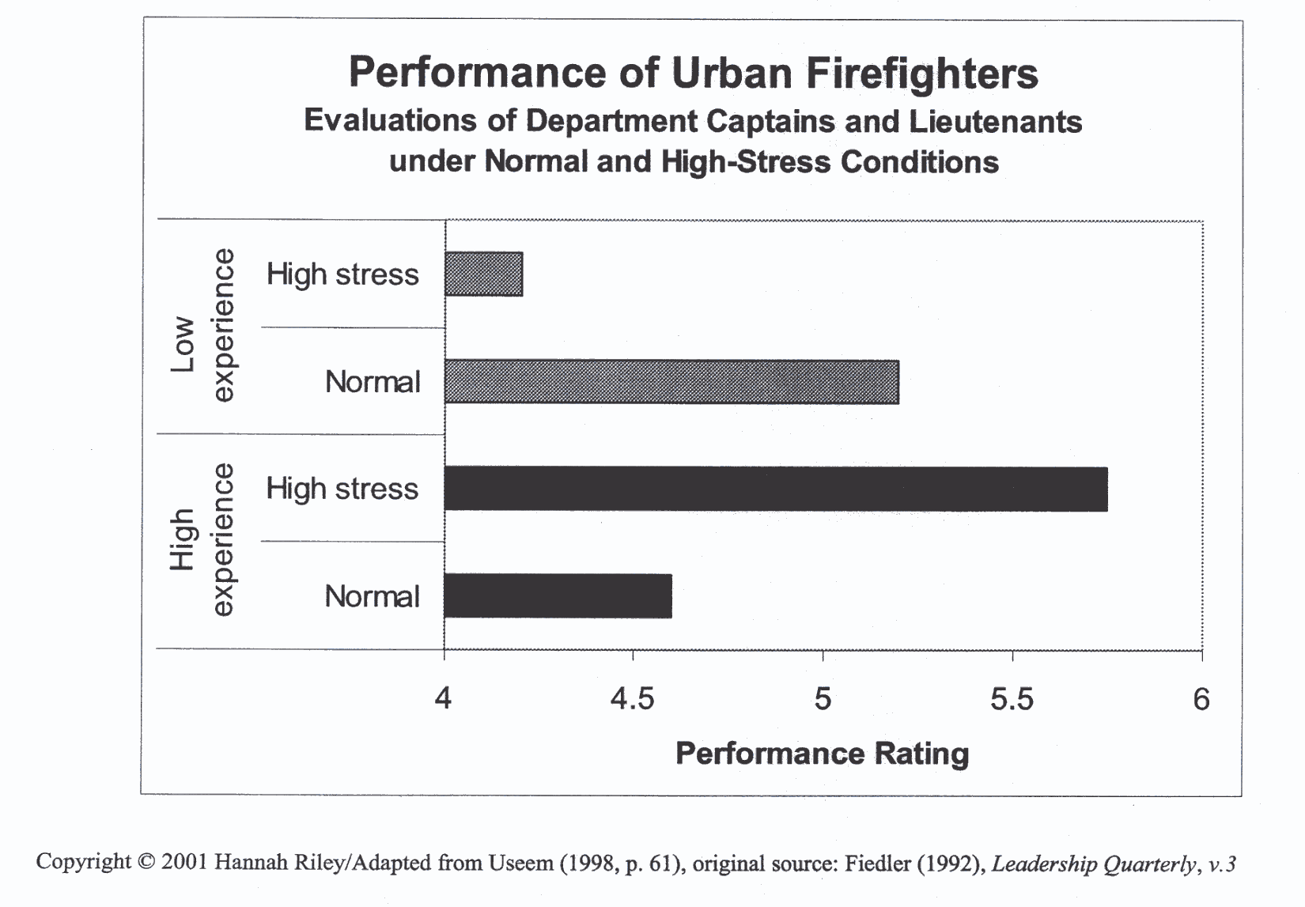
Experience Affects
Performance Under Stress

Slide 99
Rudy Giuliani:
The Man and His Moment
Leadership After September 11, 2001
Harvard University
John F. Kennedy School of Government
Run Time: 13:40

Slide 100
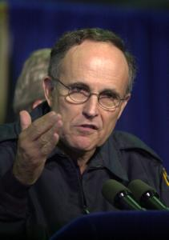
Stand Up and Be Seen
Because in a crisis, people:
  look for someone to take charge
  want guidance on how to understand rationally and respond emotionally
  respect leaders’ willingness to risk self-interest and share the crisis experience

Slide 101
Lead By Example
Model the behavior you want in others
Set the tone (Brutal Optimism) because emotions are contagious.
Maintain frequent contact and communicate

Slide 102
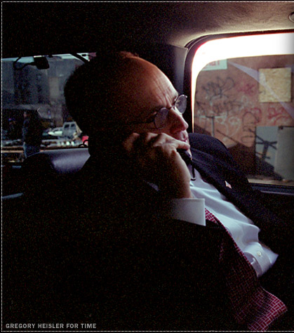
Stick to the Facts
Share what you know
Admit what you don’t
Don’t get bogged down in details
Align your words and your actions (“Walk the Talk”)
Speak straightforwardly or not at all

Slide 103
Mistakes Aren’t Irreversible
Avoid “paralysis by analysis”
People are starved for leadership
They will forgive a lot of missteps if you finally get it right
“Do What You Can at the Moment”
        Dave Scott, Six Time Winner Hawaiian Ironman Triathlon

Slide 104
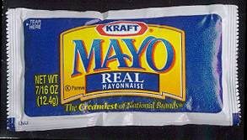
Thought for the Day
The Mayonnaise Strategy for
Leading in a Crisis
“Keep cool, but don’t freeze”

Slide 105
Bottom Line Comes Second
Put people first:
  Make them feel secure and cared about
  Emphasize responsibility to employees and the community
  Small gestures can go a long way
    donations of food, medical supplies, etc.
    time off for volunteers

Slide 106
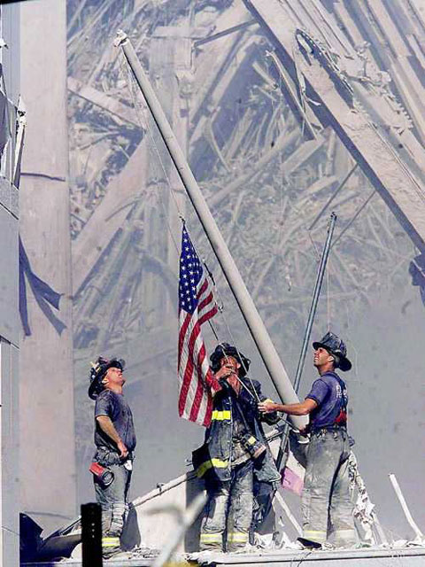
Don’t Overreach
Remember, they’re not cheering for you!
They’re cheering for themselves and their group’s performance (under your leadership)
Accept gratitude with grace but give them the credit.

Slide 107
On Your Feet!
You will now create a improvised persuasive speech.

Slide 108
Motivation
Larry Lewis
Notes:
Introduce yourselves – Name, accomplishments, things you are good at, leadership skill you would like to improve upon

Slide 109
Leadership & Motivation
Motivation – an influence that creates enthusiasm and persistence to complete actions towards a goal.
Leader’s Job – to channel the followers’ motivation towards accomplishing the team’s goals.

Slide 110
Being a motivator…
is a great way to inspire others to complete work.
means supporting and advising others to take initiative to get things done.
is believing that others must take accountability for getting things done.
means acting in a way that energizes and mobilizes others.

Slide 111
Motivators believe in…
using the talents and differences of others to best benefit the team.
trusting people on the team with the decision making process and implementation.
providing the proper tools, environment, support, and direction to allow people to accomplish tasks.
helping others on the team as a main responsibility.
Notes:
The saying should not be, “If you want something done right, do it yourself.” The saying should be, “If you want something done in exactly the method you envision, then do it yourself.” Odds are another person will do it the “right way” even if the method they use is not what you envisioned.

Slide 112

How do I motivate followers?
Fulfilling needs is what motivates a person.
You can motivate a person if you understand what their needs are.
Common needs:
  Recognition
  Friends
  Achievement
  Opportunities
  Sense of belonging

Slide 113
Motivational Model
Motivation Feedback Loop
Need creates desire to fulfill needs (money, friendship, recognition, achievement
Behavior results in actions to fulfill needs
Rewards satisfy needs: intrinsic or extrinsic rewards

Slide 114
What motivates you?
Write down three things that motivate you to do things on the robotics team.

Slide 115
Types of Motivation
Good Motivators
Bad Motivators
Achievement
Empowerment
Positive Incentives
Recognition
Good Feelings
Sense of Belonging
Development Opportunity
Rewards
Internal Fear
External Fear
Negative Incentives
Loathing
Internal Fear
Good Motivators will inspire more involvement and continuous effort.
Bad Motivators will create short term motivation and long term resentment.
Notes:
Internal Fear can be a good and bad motivator. The fear of failure can drive people to accomplish great tasks. The fear of failure can also make people obsess about things and become counter productive.

Slide 116
What motivates others?
Talk to the people around you. Find out the two major things that motivate them.

Slide 117
"To lead people, walk beside them ... As for the best leaders, the people do not notice their existence. The next best, the people honor and praise. The next, the people fear; and the next, the people hate ... When the best leader's work is done the people say, 'We did it ourselves!'"
— Lao-tsu

Slide 118
Key Factors of Motivation
Feedback
Know the person you are trying to motivate
Leadership Attitude and Motivation
Delegate things that have a purpose
Empowerment
Notes:
Feedback – People need to understand how they are doing. Provide constructive positive feedback whenever you can. If someone does a good job make sure you let them know a.s.a.p..
Know the person – Make sure you get to know the person you are trying to motivate. Understand what their motivators are and try to reward them based on those motivators.
Leadership Attitude and Motivation – As a leader you need to emanate a positive attitude when ever possible. Attitude is contagious. Also you must keep yourself self-motivated.
Delegate things that have a purpose – If you give a follower a task that is important and worth while, they will have a better sense of meaning and importance when doing the task.
Empowerment – You have to give your followers the ability to own and have some power over how things are done.

Slide 119
Empowerment & Delegation
Power sharing
Delegation of authority to followers
Benefits of Empowerment
  May be a motivator for the individual
  Increases total power of the team
  Allows use of more people’s ideas and talents
  Leaders have more time for vision, strategy, and implementation method
  Leaders can focus on new tasks that they could not do before due to being overwhelmed
One caution of empowerment
  You still need to monitor your followers and guide them.

Slide 120
Time Management

Slide 121
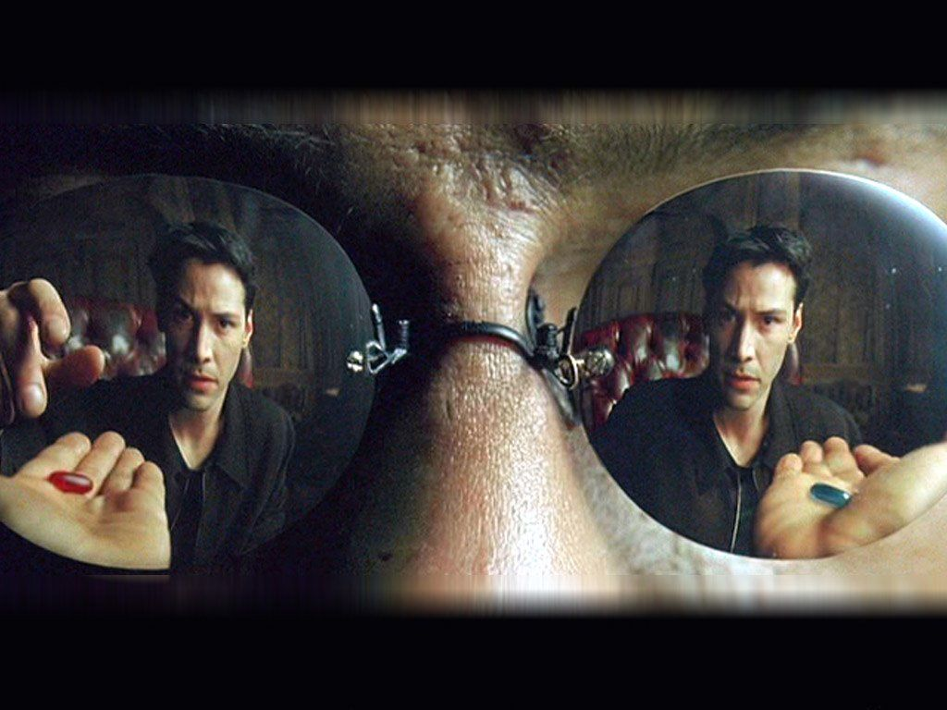
Time Management
Time is a limited resource, you need to pick what to do and what not to do.
Notes:
You only have 24 hours in a day. Make sure you use that time well.

Slide 122
Self Discipline = Time Management
You need to keep track of the activities that you are spending time on.
Make sure the activities you are doing are in line with your goals.
If time seems out of control, it means you are out of control.
You can change your habits to get back into control.

Slide 123
Good Habits = Time Management
Good habits can lead to better time utilization.
A habit is a learned behavior and can be changed.
The way to change habits is to change the way you think.

Slide 124
“Whether you think that you can, or that you can't, you are usually right.”
~ Henry Ford

Slide 125
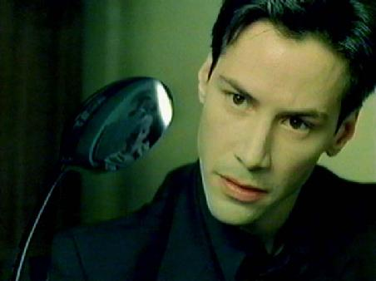
Free your mind
You will act out what you believe in.
You can’t manage time if you don’t believe you can.

Slide 126
Identify your habits
In order to determine what to change you must identify the bad habits.
Take a couple of minutes to identify activities that you do that are time wasters.
Examples: Video games, TV, surfing the net, etc.
You can do this by looking at the time log you completed before the camp.
Fill out the questions in your workbook.

Slide 127
Make the change
Now that you have identified time wasters, determine new habits to better use your time.
Write down at least one new habit you want to form.
Examples: Do homework in free periods, start to go to the gym, etc.

Slide 128
Stick to it
Make a strong commitment to the new habit.
Make sure you let others know about your commitment.
Create reminders to stick to your new habit.
Don’t stray from your new habit until it becomes second nature.
Thinking “Oh I can skip it just this once” means you have to start again.

Slide 129
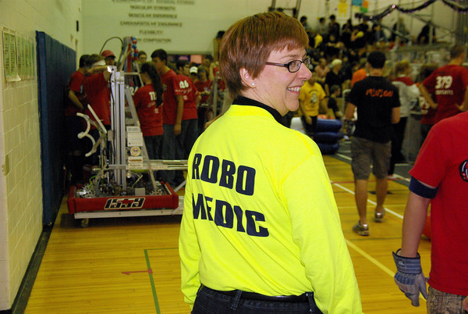
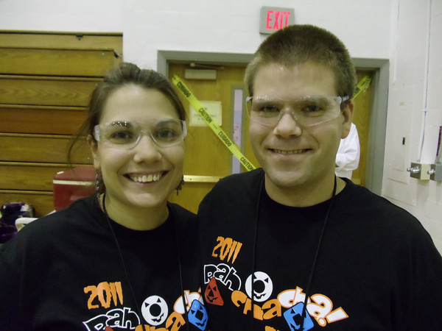

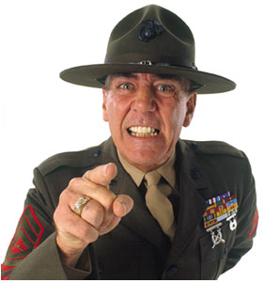
Ask others to help you!
Make sure you get someone to keep you committed to your new habit.
Could be a parent, friend, mentor, etc.

Slide 130
Factors in Time Management
Positive Attitude
Set Goals
Set Priorities
Analyze your time
Plan what to do
Schedule tasks
Analyze and limit interruptions
Meetings
Communication
Delegation
Procrastination
Team Time
Notes:
Positive Attitude: What you believe in is important. If you believe that you don’t have control, then you won’t. If you believe you do have control, you will. Make sure you practice self-discipline.
Set Goals: You need to set your goals so you can have a direction on what to work on. This is the first thing you need to do to make progress. Your goals can be in school, robotics, and life.
Set Priorities: Determine what is important and what is urgent. Some things are both but some things are urgent and unimportant. Try to focus on the urgent important things first, then the not urgent important things second.
Analyze your time: Keep track of what you are spending your time on. This will allow you to identify time wasters and how to create new habits to avoid wasting time. Keep a time log to help you track time.
Plan what to do: Come up with daily and weekly “To Do” lists to keep track of what you need to accomplish. Make sure your plans align with your goals. Break bigger goals into smaller tasks and plan them.
Schedule tasks: Schedule time during your day to complete tasks. Be realistic about the amount of time you will need to accomplish the task. Don’t schedule every minute of your day. Schedule time to yourself to decompress and clear your mind. Try to start your day early and when you start dig right into your work.
Analyze and limit interruptions: Analyze what interrupts you and look for patterns. You may be able to address the root cause of the interruption.
Meetings: Always make sure you have an agenda for a meeting. If you don’t have anything to do at a meeting then don’t have it.
Communication: Avoid communication overload. Only read the important materials. Discard the irrelevant.
Delegation: It is important at times to delegate work in order to share the workload to complete the task on time. Make sure that when you are delegating that you explain what you want in clear detail and support them if they need help.
Procrastination: This is one of the major things that prevents success. Putting things off only further compresses the amount of time you have to complete tasks and usually leads to poorer quality for the tasks you complete.
Team Time: When on a team, make sure that you are aware of the deadlines of the team and your part in making those deadlines.

Slide 131
Thoughts regarding Attitude
It is not enough to know; you must also act. Knowledge without action is powerless.
Besides the noble art of getting things done, there is the noble art of leaving things undone. The wisdom of life lies in eliminate the non essentials. ~ Chinese proverb
“Habits are the key to success. Successful people form the habit of doing the things that others don’t like to do. ~ Earl Nightingale

Slide 132
Procrastination
Why do people do it?
  When the task is unpleasant.
  When the task is difficult.
  When the task involves tough decisions.
Putting things off does not make it disappear.
It is better to address the task as soon as you can.
Don’t defend your procrastination habit. If you defend, deny, or rationalize it then you will not improve.
  Example: “Well, I am not really in the mood to do that right now” or “ I can always do it later”
Make sure you accept the fact you are procrastinating and take action.

Slide 133
Tips for handling Procrastination
Do the toughest tasks first.
Break big tasks into smaller ones.
Don’t worry about it being perfect just try to complete it.
Don’t wait for the right mood. Just push yourself to start.
Stick to deadlines.
Promise yourself a reward if you complete the task. Example: Video Games, TV, etc.

Slide 134
Things to remember from Boot camp
Be an initiator
Understand the makeup of your team
Know your strengths and hone them
Drive towards excellence in everything you do
Improve and maintain your relationships
Have empathy for others
Sharpen the Saw
Practice your presentation skills
Inspire and motivate others
Don’t procrastinate and effectively utilize your time

