Slide 1
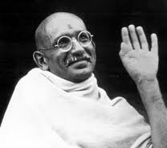
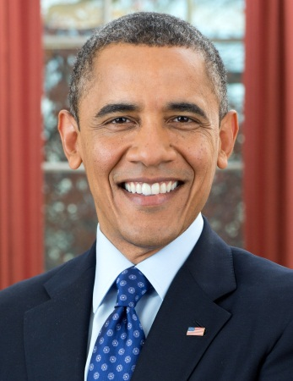
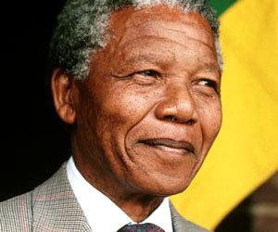
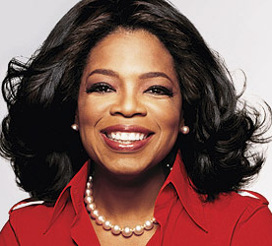
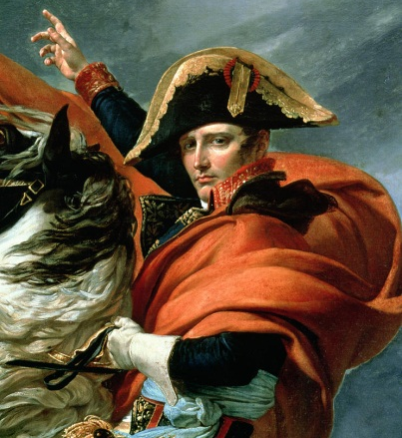
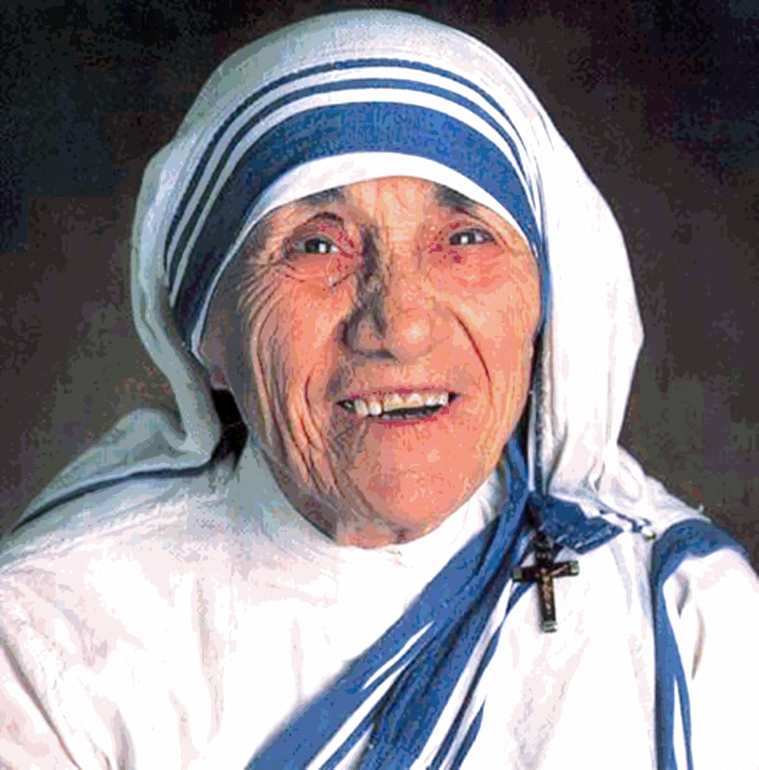
Leadership Boot Camp
Notes:
1
Welcome to Leadership Boot Camp! This first slide has several leaders. Some you may agree with and others you may disagree with, but they’re all leaders because people follow them. They have or had ideas that people followed and for some, worshipped them. (Have kids tell me who each one was)
As you can see, there are definitely different kinds of leaders and some leaders are more obvious than others.
Feel free to interject with questions, points, etc. We want this to be an open dialogue to help you understand leadership better.

Slide 2
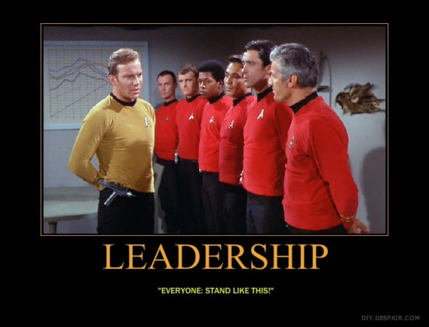
Leadership Characteristics
What are the characteristics of a good leader?
Notes:
2
Some of this might be repetitive for those of you who have been at leadership boot camp before, but part of leadership is growing and constantly improving, which we’ll get into later. It’s important to go back and revisit some of the basic concepts in order to grow and improve and see where you’ve come from. It’s like calculus. You can do complicated equations, but you can’t forget to add and subtract, or you’ll never be able to do calculus well. What we’re starting with today is the foundation of your leadership skills.
There is no definitive list of characteristics that describes all leaders
No two leaders have the exact same sequence of strengths
They may have identical expectations, but the way they reach their goals is always dependent on their unique arrangement of their strength

Slide 3
“If you spend your life trying to be good at everything, you will never be great at anything.”
Notes:
BREAK

Slide 4

Four Parts of Leadership
Know
Yourself
Communicate Effectively
Continuous
Improvement
Be a Good Team Player
Notes:
We will discuss all four parts throughout today
Self awareness is a crucial part in personal development

Slide 5
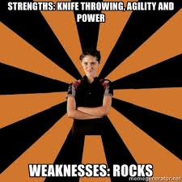
Know Yourself
Strengths and Weaknesses
Biases and Beliefs
Empathy
Notes:
If you know your strengths and weaknesses, you know what to play up and what you can improve upon.
Biases and Beliefs affect the way you interact with others. As a leader, don’t necessarily like everyone you’re leading, but you still have to work with them constructively. Can someone name a bias or belief that may impede one’s ability to lead?
If you are aware of these, then you can put them in check when interacting with followers and teammates.
Empathy allows you to see past the bias. Try to understand the other reasons of why they may be acting out. Try asking some questions about what’s going on with them to have some understanding of the situation. And then you can understand how to resolve it in a non-confrontational or negative way.
You make an assumption, the person feels hurt by that assumption (the way you spoke to them, what you said to them, the fact that you’re assuming the wrong thing about them), they get defensive and now it creates a conflict.
Helps you understand any barriers or limitations you may have

Slide 6
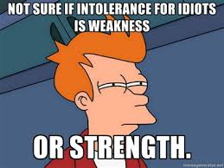
Effective Leadership
Always invest in strengths
Surround yourself with the right people and then maximize your team
  The best leaders are not well-rounded, but the best teams are.
Understand your followers’ needs

Slide 7
Maximize Your Team
Recruit based on the individual’s strengths and how they can maximize the rest of the group’s strengths
Four distinct domains of leadership strength:
    Executing: know how to make things happen
    Influencing: help their team reach a broader audience; selling the team’s ideas inside and outside the organization
    Relationship Building: hold the team together
    Strategic Thinking: keep everyone focused on what could be; help the team make better decisions
Notes:
There is a table on page 3 in your work book that shows where your talents fit. Take a few minutes to find out where your strengths fall in the four domains. Give them 5 minutes to share.

Slide 8
Maximize Your Team (cont.)
A good team has representation of each of these domains – makes a well-rounded team
  Example - My strengths are:
Executing | Influencing | Relationship Building | Strategic Thinking
Faith | Self-Motivation | Integrity | Innovation
 |  |  | Strategic Thinking
Notes:
Common theme:
In order to be a great leader, you need to be great at many things
In reality, it is difficult to be great at many things
You must find others who are great at the things that you’re not and develop a leadership team

Slide 9
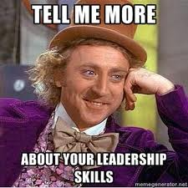
Know Yourself
Strengths Finder Test Results!
http://richardstep.com/richardstep-strengths-finder-rssf/
Notes:
Share their 5 talents – fill in 4 domains
We all lead in different ways, based on our talents and limitations

Slide 10
“The most effective leaders stay true to who they are – and then make sure they have the right people around them to create unprecedented growth.”
Notes:
BREAK

Slide 11

Confidence
Without an awareness of your strengths, it’s almost impossible for you to lead effectively
  Focusing on your or others’ strengths builds confidence
  People with higher self-confidence
    ended up with higher income levels
    and career satisfaction
Notes:
The last part we’ll talk about for knowing yourself is confidence

Slide 12
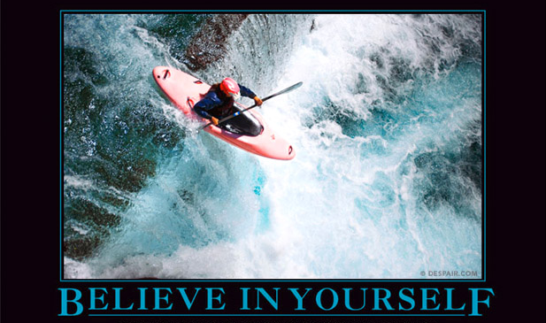
Confidence
You need to believe in yourself and your capabilities before anyone else will
Self-efficacy is an important part of self-confidence.
Bandura’s Theory - 4 sources of self-efficacy:
  Mastery experiences - things you have succeeded at in the past
  Vicarious experiences - seeing people who are similar to you succeed
  Social persuasion* - hearing from others that you're capable
  Emotional status - staying positive and managing stress
Notes:
Albert Bandura – famous psychologist who focused on behavior and observational learning
His most famous experiment was the 1961 Bobo doll study. In the experiment, he made a film in which a woman was shown beating up a Bobo doll and shouting aggressive words. The film was then shown to a group of children. Afterwards, the children were allowed to play in a room that held a Bobo doll. The children immediately began to beat the doll, imitating the actions and words of the woman in the film.
The study was significant because it departed from behaviorism’s insistence that all behavior is directed by reinforcement or rewards. The children received no encouragement or incentives to beat up the doll; they were simply imitating the behavior they had observed. Bandura termed this phenomena observational learning and characterized the elements of effective observational learning as attention, retention, reciprocation and motivation.
Self-efficacy - measure of the belief in one's own ability to complete tasks and reach goals
Read off 4 things
The first, second and fourth sources are within your control. However, social persuasion is not as we can’t force people to say good things about us , but we can increase the likelihood of receiving positive feedback by being more confident in general. WITHOUT being arrogant or conceited
Mastery experiences: The more success you experience, the more success you're likely to enjoy in the future. But if success comes too easily, it probably won't contribute to your self-confidence. Mastery experiences are those achievements where you know that it was your hard work and effort that brought about success.
Vicarious experiences: Part of Bandura's theory is the idea that seeing other people's success improves your belief in yourself. If you view yourself as similar to someone else, and you see his/her accomplishments, you're likely to apply that to yourself, and believe that you can achieve similar success.
The more alike you think you are, the greater the influence. If you see others working hard and succeeding, that can also motivate you and build your confidence.
The opposite may also be true. If you see people make great efforts and not achieve anything, that can hurt your confidence - especially if you think your talents and abilities are similar to theirs.
Emotional Status: If you let stress control you, chances are you'll feel very negative. You may interpret the stress as failure, which can lead to more stress and negative thinking.
Being good at managing stress, however, can be a source of confidence: if you believe you can handle anything you might reasonably face, this can give you energy and a feeling of power. You can build this kind of positive emotion when you learn how to control the sources of stress in your life.
To be confident, you must be positive. Face stressful situations directly, and learn strategies for managing them.

Slide 13
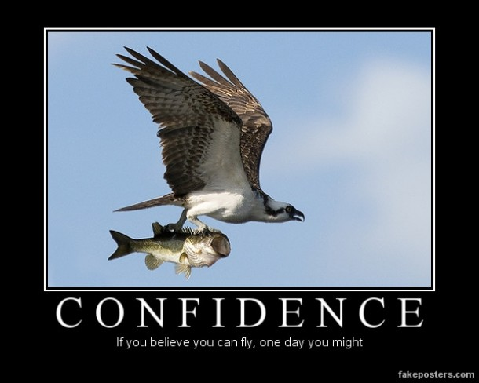
Confidence
Quiz yourself!
Notes:
Go to your workbooks and fill out the confidence quiz
The results will tell you how confident you are. I also include some helpful tips to help you with some of these sources of self-efficacy if you scored yourself low on certain questions.

Slide 14
Improving/Maintaining Relationships
Understand the person
Keep commitments (stability)
Clarify expectations
Attend to little things (say “Thank you!”)
Show personal integrity (moral character)
Willing to admit when you’re wrong or when you’ve wronged the person
http://www.lifetrainingonline.com/blog/the-emotional-bank-account.htm
Notes:
Social Persuasion
In order to increase Social persuasion, you need to improve and maintain relationships. Here are several tips on how to do this. These are called emotional bank accounts. Try to put in more than what you take out.

Slide 15
Increasing Leadership Confidence
1. Decide if you really want to be a leader. The uncertainty and ambiguity of leading people can be very unsettling.
2. Make peace with ambiguity in decision-making. There are usually no clear right answers when making complex business decisions.
3. Gather a reasonable amount of data, involve people, then follow your gut and do what you think is right.
4. Accept the fact that you are going to fail on occasion. All humans do.

Slide 16
Increasing Leadership Confidence
5. Have fun! Why should you expect those who you lead to demonstrate positive enthusiasm, if they don't see it in you?
6. Once you make a decision, commit and go for it. Don't continually second guess yourself. If you have to change course, you have to change course. If you never commit, all you will ever do is change course.
7. Demonstrate courage on the outside, even when you don't feel it on the inside. (Fake it till you make it) If you are going to lead people in tough times, you will need to show more courage than fear (i.e. Rudy Giuliani during 9/11).

Slide 17
“We gain strength, courage, and confidence in which we really stop to look fear in the face... we must do that which we think we cannot.” ~Eleanor Roosevelt
“If once you forfeit the confidence of your fellow-citizens, you can never regain their respect and esteem.” ~Abraham Lincoln
Notes:
BREAK For 5 minutes then do activity

Slide 18
ACTIVITY!
Notes:
Beach ball activity or Amy’s straw activity

Slide 19
Understanding Why People Follow
Critical to know what the people around you need and expect from you
Followers’ 4 Basic Needs:
    Trust (honesty, integrity, respect)
    Compassion (caring, friendship, happiness, love)
    Stability (security, strength, support, peace)
    Hope (direction, faith, guidance)
        A higher level need; future
Notes:
19
The chances someone will do good work if they do not trust their leader is 1/12. If they trust their leader, it’s 1 in 2 (a 6 –fold increase)
Trust – when two people know each other well, they tend to work faster
Compassion – people who feel like they are cared about are more likely to stay with the organization and are more engaged in team activities
Hope – When hope is absent, people lose confidence

Slide 20
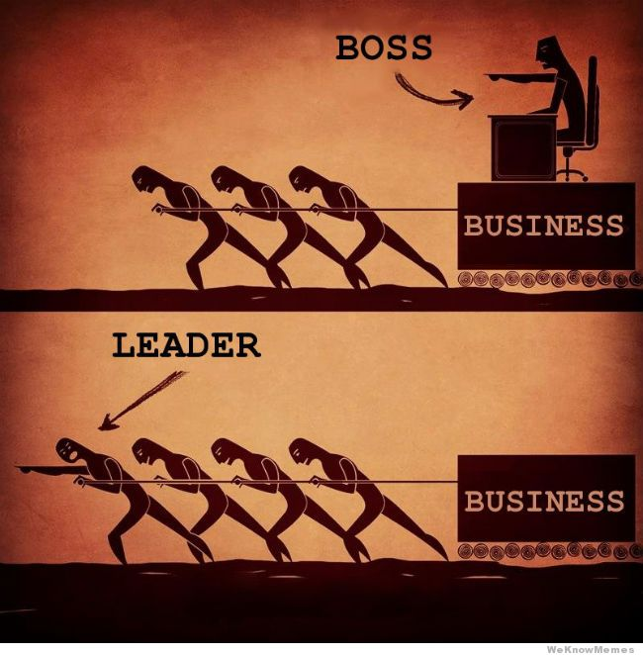
“The most extraordinary leaders do not see personal success as an end in itself. They realize that their impact in this world rests in the hands of those who follow.”

Slide 21
The 7 Habits of Highly Effective People
Be Proactive
Begin with the End in Mind (Goals)
Put First things First (Prioritize)
Think Win/Win (Strategize)
Seek First to Understand, then to be Understood (Communication)
Creative Cooperation
Sharpen the Saw
Notes:
Just go over these quickly
Be Proactive (go to next slide)
Seek first to understand – switch two slides up
Creative Cooperation
Teamwork, open-mindedness, the adventure of finding new solutions to old problems
Trust & Cooperation are HIGH
Find the 3rd Alternative: a better way that hasn't been thought of yet.
Sharpen the Saw: Self Renewal, continuous improvement, improving upon your talents by investing in them with knowledge and skills
Balanced program in the four areas of your life: physical, social/emotional, mental, and spiritual

Slide 22
Proactive/Reactive Language
Reactive
There’s nothing I can do
That’s just the way I am
He makes me so mad!
They won’t allow that
I have to do this
I can’t
I must
If only
Proactive
Let’s look at the alternatives
I can choose a different approach
I control my own feelings
I can create an effective presentation
I will choose an appropriate response
I choose
I prefer
I will

Slide 23
Seek First to Understand,
Then to be Understood
Principles of Empathic Communication
Empathic Listening (putting yourself in the other person’s shoes)
Diagnose before you Prescribe
I statements
Understanding & Perception
THEN Seek to be Understood
Notes:
23
Because you so often listen autobiographically, you tend to respond in one of four ways:
Evaluating: You judge and then either agree or disagree.Probing:You ask questions from your own frame of reference.Advising:You give counsel, advice, and solutions to problems.Interpreting:You analyze others' motives and behaviors based on your own experiences.

Slide 24
Tips on Being a Good Listener
Eye contact
Be aware of body language (minimize barriers)
Minimize distractions (looking out the window, fidgeting, side conversations)
Try to understand what the other person is saying and respond to what they are saying
  Reflection
  Repetition
  Response
Notes:
Part of empathy is being a good listener
These are all counseling techniques:
Reflection – reflect what they just said in your own words to show you understand what they said
Repetition – repeat what they just said, “Yes, we should get ice cream after boot camp.”
Response – answer a question they asked or provide an appropriate response to what they just said

Slide 25
The 8th Habit
Find your Voice and Inspire others to find theirs
Leadership is a choice to deal with people in a way that will communicate to them their worth and potential so clearly they will come to see it in themselves
Develop a shared vision

Slide 26
“Leaders are only as strong as the connections they make with each person on their team.”
Notes:
BREAK?

Slide 27
ACTIVITY!
Notes:
Compromise – Larry
Break students up into two’s and divide out into the rooms, tell them to find a space away from everyone else
5 minutes to read over scenario
10 minutes to deliberate
Come back to the room and discuss

Slide 28
Compromise Activity
Take 5 minutes to carefully read over your own scenario – do NOT share with your partner
Familiarize yourself with the role that you will play in the conflict resolution activity
Break up into two’s (pick someone you have not worked with before)
Find a space away from everyone else in one of the rooms or hallways
Spend 10 minutes to act out your role and achieve your goal
Come back to the room and discuss

Slide 29
Compromise Activity
Did your group not come up with a resolution? If not, what were the issues?
Did your group reach an agreement? If so, what was it?
Did your group discover the true needs of each other?
Groups that discovered the true needs, how did you figure that out?

Slide 30
Compromise Activity
Key Takeaways
Make sure you listen and understand the other persons situation. (Empathic listening)
Try to focus past the initial position the person is taking and focus on the details of the issue.
Try to stay calm, it is easy to get upset
Always believe that there is a resolution that works for both parties even if it is hard to see initially.

Slide 31
“The most effective leaders forever alter the course of your life.”
Notes:
BREAK FOR LUNCH???

Slide 32
Effective Communication and Presentation Skills

Slide 33
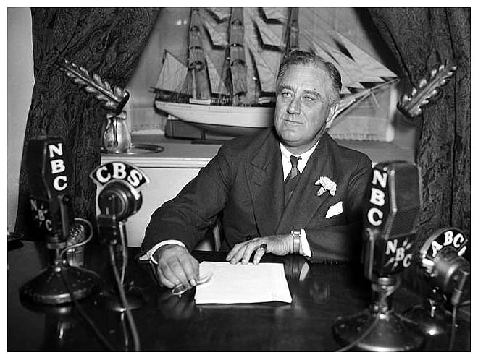
FDR on Public Speaking
“Be prepared,
be brief,
be seated”
Franklin Delano Roosevelt

Slide 34
Three Keys to a Great Speech
Elements of oratory
Narrative
Finding one’s own voice

Slide 35
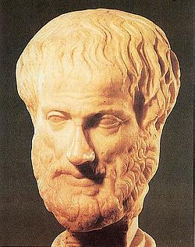
Greek Elements of Oratory
Source- Aristotle,
Rhetoric, 355 B.C.
Ethos- Credibility & Likability
  Why should we care what you say?
  Your introduction can establish “ethos”
  Self deprecating humor breaks down barriers

Slide 36



Elements of Oratory
Logos- Strength of Argument
  The strength of the argument relies on facts and logical thinking that can’t be refuted.
  3 points are often effective.
  Support arguments with facts & figures. The best are surprising (Stickiness Factor).
Notes:
The best fact – if I was giving a speech about childhood nutrition in America and told you that there are 16.7 million children in the US who suffer from starvation and malnutrition, that surprises your audience and gives them something to think about. It is the shock factor that causes the fact to stick.

Slide 37
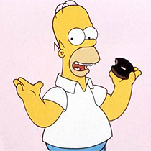
“Facts are meaningless; you can use facts to prove anything that’s even remotely true! Facts, schmacks.”
Homer Simpson
1997

Slide 38

Elements of Oratory
Pathos- Appeal to the Heart
  Leadership is not just from the head up, but neck down too.
  Values can be more powerful than facts.
  (“If we really believe XX, then we must do YY.”)

Slide 39
One Common Approach
Open with Ethos-- Establish credibility
Argue with Logos-- Make your case
Close with Pathos-- Send them away wanting more (Upper vs. Downer)

Slide 40

Steve Jobs
Apple Co-Founder
2005 Commencement Speech at Stanford University
http://news.stanford.edu/news/2005/june15/jobs-061505.html
Notes:
Look out for the ways that he incorporates ethos, logos, and pathos – discuss at end: How did he incorporate ethos? Logos? and pathos?
Maybe even discuss ways that he could have improved as a speaker? What did you like and not like about the speech?

Slide 41
Narrative
Stories appeal to people
Long ones better have a good punch line
Stories must be relevant and make a point
Often effective to bring past and future to the present
  Where we have been
  Where we are now
  Where we are going

Slide 42
Finding Your Own Voice
“Voice” is your style, your perspective
Consistency is a virtue. People won’t trust you if you’re all over the place.
Followers want the Deeper Level
  -Who you are -The Inner You
Passion must be authentic. Nobody follows a phony.
Notes:
BREAK

Slide 43
Tips for a
Great Presentation

Slide 44
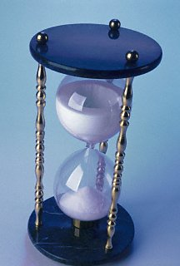
Tip #1 for a Great Presentation
Start early. Remember the
1 minute = 1 hour rule
Work expands to fill the time
available to complete it
Notes:
1 minute of your speech should take 1 hour to prepare

Slide 45
Tip #2 for a Great Presentation
Be sure you know (and don’t forget)
  Who is your audience?
  What is your purpose? (inform, persuade, entertain, other?)
  What is your message?

Slide 46
Tip #3 for a Great Presentation
Decide on an approach for the presentation.
  Top Down
  Bottom Up
  Other
Some plan beats no plan

Slide 47
Tip #4 for a Great Presentation
Three rules for powerful presentations
  Focus on something you really care about
  Incorporate personal experiences in your presentation
  Structure your presentation like a story
Communicate meaning - not just words

Slide 48
Tip #5 for a Great Presentation
Use audio/visual aids sparingly & only to enhance your narrative
  What kind of aids to use? (photos, samples, flip charts, video clips, others)
  Where, why, how many?
  Avoid aids that are distracting or increase risk of failure
The PowerPointless Challenge

Slide 49
Tip #6 for a Great Presentation
Three steps for better PowerPoint slides
  Emphasize graphics not words
  Use reverse contrast color schemes
  Keep them simple
Follow the 6 X 6 rule

Slide 50
Tip #7 for a Great Presentation
Own the room!
  Rehearse where you will speak
  Check out all equipment in advance
  Always have a “Plan B” in case of failures
Never Forget - Stuff Happens!

Slide 51
Tip #8 for a Great Presentation
Some strategies for managing stage fright
  Prepare & learn your material (memorize it all, speak from notes, read text but memorize first & last minute)
  Focus on the audience, not yourself
  Employ effective eye contact (3 second guide)
  Psych yourself up! Turn anxiety into energy
The audience wants you to succeed

Slide 52
Tip #9 for a Great Presentation
The final steps to a great presentation
  1. Rehearse and revise.
  2. Rehearse and revise
  3. Repeat steps 1 and 2
Reinforce what’s good - Revise what’s not

Slide 53
Composing a Speech

Slide 54


Composing A Speech
Who Is My Audience? Understand your immediate and extended audience. What stories, metaphors, and language will connect with them?
What Is It You’re Going to Say? Know with precision. Reduce to one paragraph. Write it out.

Slide 55
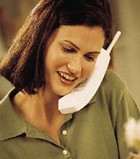



Composing A Speech
How Will the Broader Audience Hear or Read What I’ve Said? Audience beyond the room may get hearsay or read sound bites. How well will your message travel?
Who Are You and What’s Your Voice ?
Your talk must sound like you.

Slide 56
On Your Feet!
You will now create a speech
Pick a topic you are PASSIONATE about – it can be anything!
2 minute long speech
15 minutes to prepare
Notes:
Allow students to go off into different rooms and find a space to jot down notes
Anything (but appropriate!)
2 minutes – we don’t expect you to take 3 hours to do this using the 1 minute = 1 hour rule

Slide 57
Motivation
Notes:
Introduce yourselves – Name, accomplishments, things you are good at, leadership skill you would like to improve upon

Slide 58
Leadership & Motivation
Motivation – a influence that creates enthusiasm and persistence to complete actions towards a goal.
Leader’s Job – to channel the followers’ motivation towards accomplishing the team’s goals.

Slide 59
How do I motivate followers?
Fulfilling needs is what motivates a person.
You can motivate a person if you understand what their needs are.
Common needs:
  Recognition
  Friends
  Achievement
  Opportunities
  Sense of belonging

Slide 60
Motivational Model
Motivation Feedback Loop
Need creates desire to fulfill needs (money, friendship, recognition, achievement
Behavior results in actions to fulfill needs
Rewards satisfy needs: intrinsic or extrinsic rewards

Slide 61
What motivates you?
Write down three things that motivate you to do things on the robotics team.
Be prepared to share those motivators with the group.
Write two things that motivate others around you.

Slide 62
Types of Motivation
Good Motivators
Bad Motivators
Achievement
Empowerment
Positive Incentives
Recognition
Good Feelings
Sense of Belonging
Development Opportunity
Rewards
Internal Fear
External Fear
Negative Incentives
Loathing
Internal Fear
Good Motivators will inspire more involvement and continuous effort.
Bad Motivators will create short term motivation and long term resentment.
Notes:
Internal Fear can be a good and bad motivator. The fear of failure can drive people to accomplish great tasks. The fear of failure can also make people obsess about things and become counter productive.

Slide 63
Key Factors of Motivation
Feedback
Know the person you are trying to motivate
Leadership Attitude and Motivation
Delegate things that have a purpose
Empowerment
Notes:
Feedback – People need to understand how they are doing. Provide constructive positive feedback whenever you can. If someone does a good job make sure you let them know a.s.a.p..
Know the person – Make sure you get to know the person you are trying to motivate. Understand what their motivators are and try to reward them based on those motivators.
Leadership Attitude and Motivation – As a leader you need to emanate a positive attitude when ever possible. Attitude is contagious. Also you must keep yourself self-motivated.
Delegate things that have a purpose – If you give a follower a task that is important and worth while, they will have a better sense of meaning and importance when doing the task.
Empowerment – You have to give your followers the ability to own and have some power over how things are done.

Slide 64
Empowerment
One of the most important ways to motivate people
Power sharing
Delegation of authority to followers
Benefits of Empowerment
  May be a motivator for the individual
  Increases total power of the team
  Allows use of more people’s ideas and talents
  Leaders have more time for vision and strategy
  Leaders can focus on new tasks that they could not do before due to being overwhelmed
One caution of empowerment
  You still need to monitor your followers and guide them.

Slide 65
Taking Action

Slide 66
Thoughts regarding Taking Action
It is not enough to know; you must also act. Knowledge without action is powerless.
“Whether you think that you can, or that you can't, you are usually right.” ~ Henry Ford
“Habits are the key to success. Successful people form the habit of doing the things that others don’t like to do. ~ Earl Nightingale
Action is the foundational key to all success. ~ Pablo Picasso
An ounce of action is worth a ton of theory. ~ Ralph Waldo Emerson

Slide 67
Taking Action
It is important to have vision and ideas, but it is equally important to act on those ideas.
There are many factors why actions are not taken.
Two major factors in not taking action are:
  Priority
  Procrastination

Slide 68
Setting Priorities
What you want/have to do you will prioritize higher than other tasks.
Make sure you prioritize the tasks you have to get done over less important tasks.

Slide 69
Procrastination
Why do people do it?
  When the task is unpleasant.
  When the task is difficult.
  When the task involves tough decisions.
Putting things off does not make it disappear.
It is better to address the task as soon as you can.
Don’t defend your procrastination habit. If you defend, deny, or rationalize it then you will not improve.
  Example: “Well, I am not really in the mood to do that right now” or “ I can always do it later”
Make sure you accept the fact you are procrastinating and take action.

Slide 70
Tips for handling Procrastination
Do the toughest tasks first.
Break big tasks into smaller ones.
Don’t worry about it being perfect just try to complete it.
Don’t wait for the right mood. Just push yourself to start.
Stick to deadlines.
Promise yourself a reward if you complete the task. Example: Video Games, TV, etc.

Slide 71
Take Home Messages
Understand your strengths
Maximize your team’s strengths
Have Confidence
Drive towards excellence in everything you do
Improve and maintain your relationships
Practice empathy when listening to others
Strive for continuous improvement
  Balanced Self Renewal (physical, social, mental, spiritual)
Practice your presentation skills
Inspire and motivate others
Don’t procrastinate!

Slide 72
Survey
http://www.surveymonkey.com/s/VZWR6N7
Thank you!!

